Slide 1
Future ISPyB Architecture at Diamond
ISPyB Collaboration November 2023

Slide 2
ISPyB Usage Today
What we store
References to LIMS data primarily MX and EM (not exclusively)
14664 Proposals, 1.8 million Samples, and 4.2 million Data Collections
Who accesses
DAQ, Analysis, Beamline applications
How access
Direct SQL and 190 stored procedures
Collection of legacy APIs
Data ingestion scripts
Dependencies
Beamlines require constant access to function
1300 queries per second
Source of truth for authorisation
See next slide for details

Slide 3
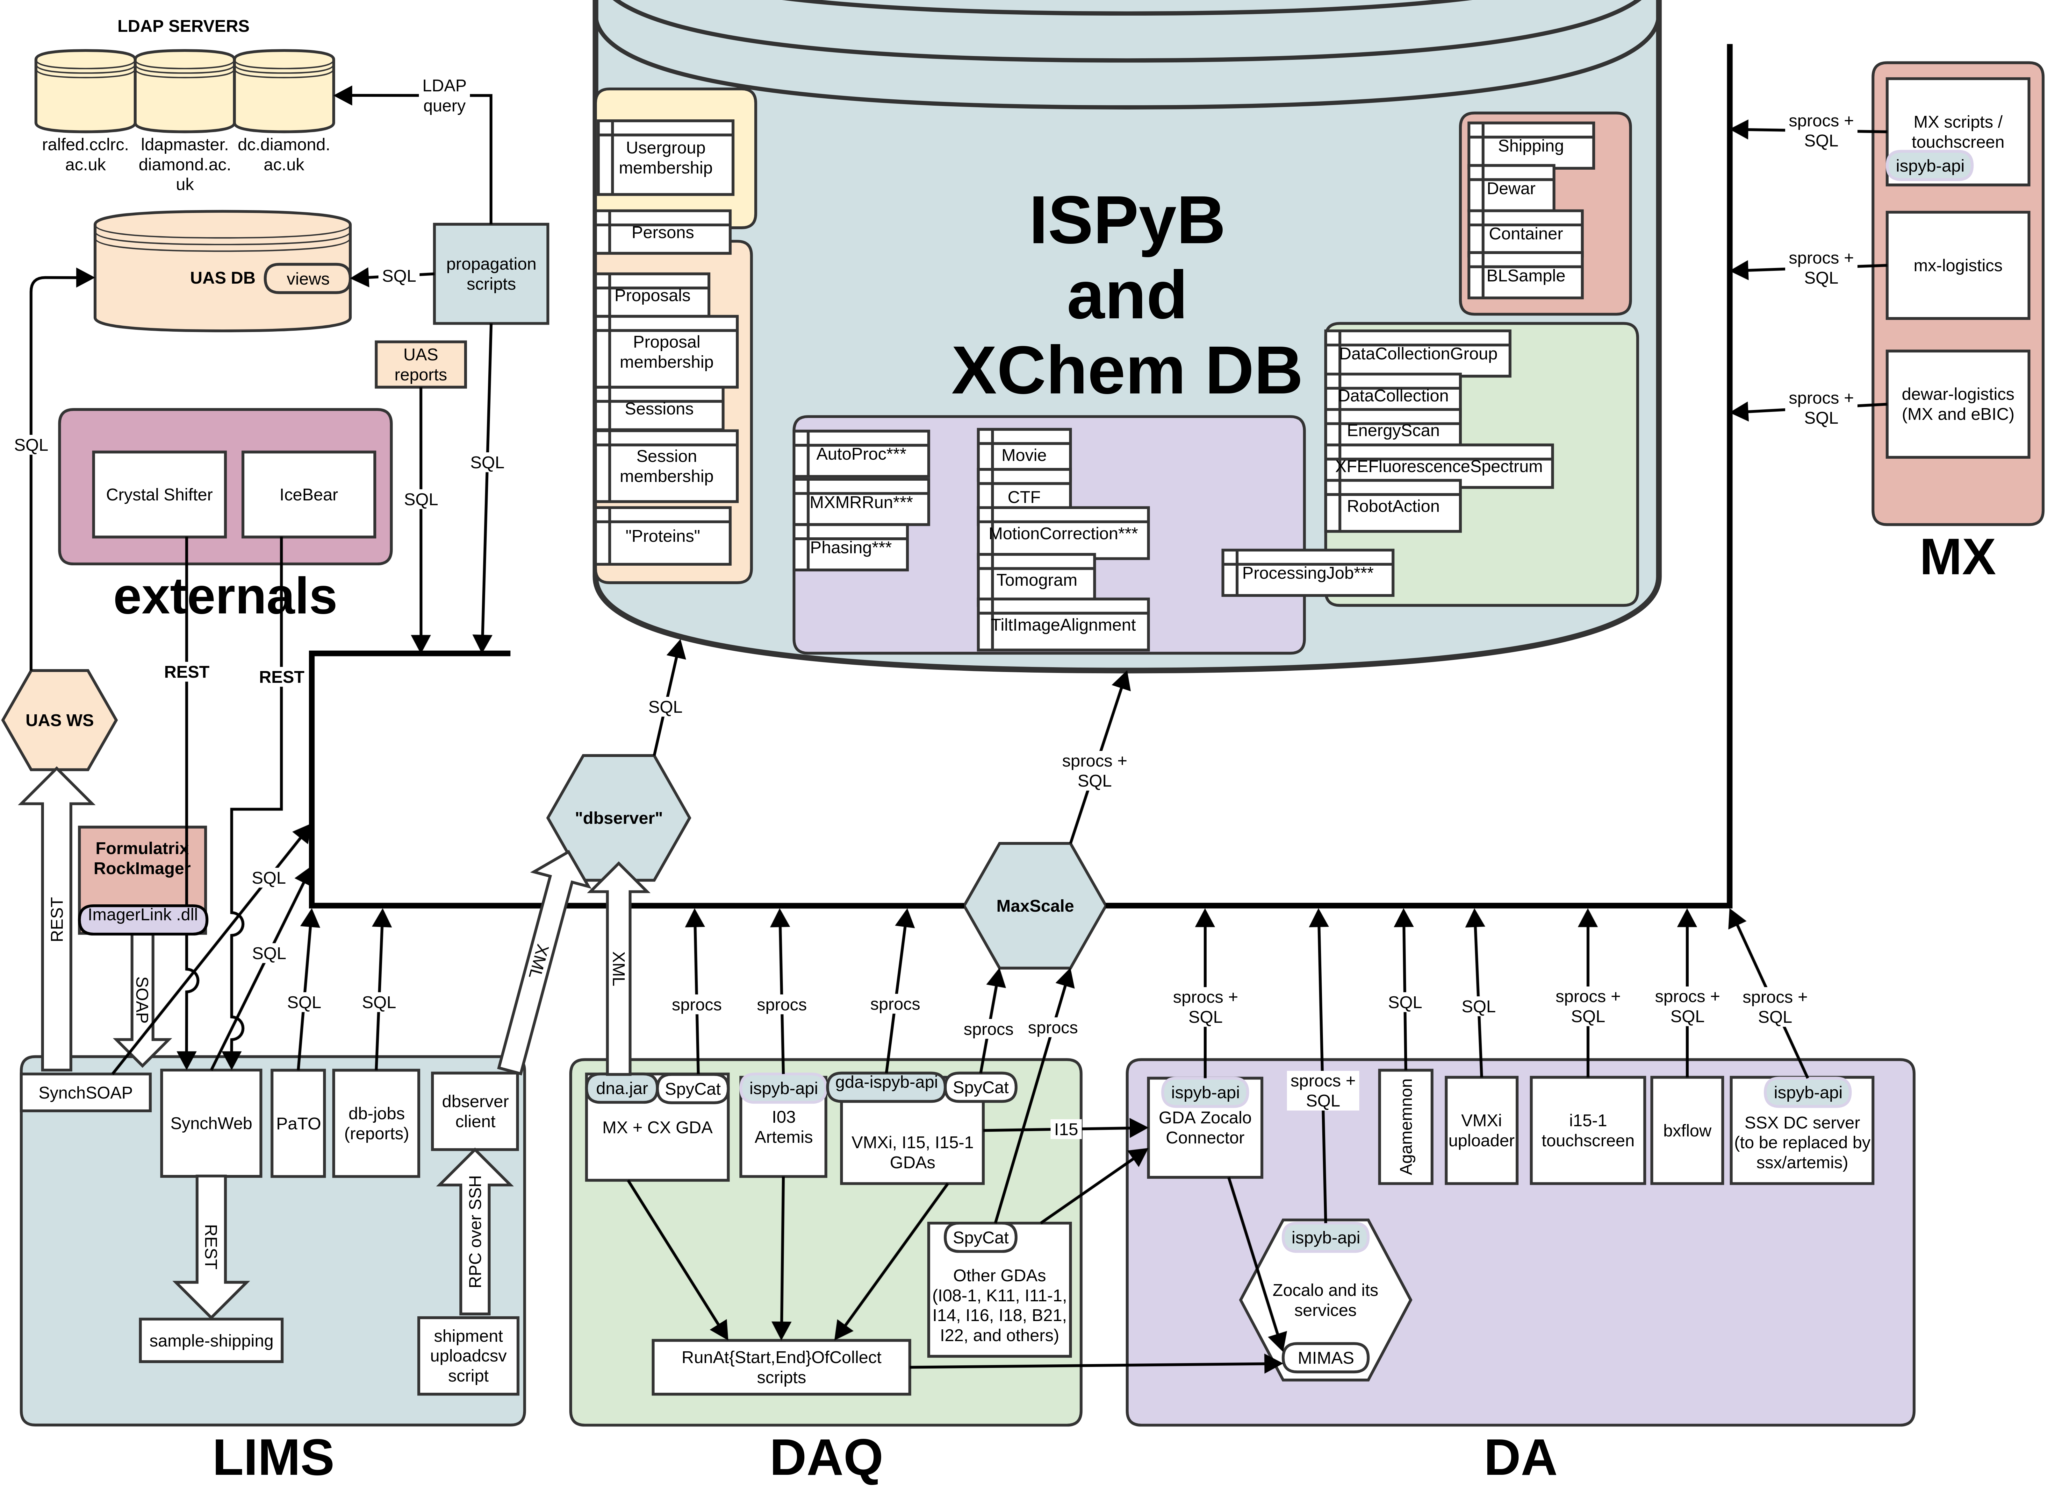

Slide 4
ISPyB Database Today
Schema
Has grown with the community over the past 20 years.
Customised for Diamond
Mixes science and operational data
Difficult to apply to other science areas
Has become a single source of truth for other applications at Diamond
Records all operational data from Dewar Tracking to measuring Beamline efficiency
Extensively used by MX, EM, and Powder Diffraction
Direct Access
Multiple legacy APIs: maintenance burden, security risks
"Fixed" schema
Changes must be coordinated with app owners
Legacy features are difficult to refactor
Noisy Neighbours could result in service disruption
Query performance: queries beyond LIMS control / quality checks
This model does not scale to predicted data volumes
The existing APIs and direct database access are insecure

Slide 5
SynchWeb Today
Is the backbone of the MX and EM processes
For UDC has become the UI for Facility Users
Only beamline staff and engineers use acquisition tools for commissioning
Authorisation based on proposal information
Sample Definition, Shipping, Data Analysis Reprocessing, etc.
Lots of technical debt
PHP7 with Cyber Security vulnerabilities
JavaScript frameworks (Vue, Marionette, Backbone)
20+ complex web pages to maintain
Logistics written and maintained by Beamline staff
PATo (duck in Portuguese)
EM RELION pipeline data viewer
Uses Py-ISPyB technology stack FastAPI, React, etc.

Slide 6
Py-ISPyB Evaluation
Technical Assessment from January to March 2023 perform by external contractor.
Linked directly to the Diamond Test ISPyB instance
Without access the to the Java Webservices we could only evaluate the following pages: Data Collection, Proposals, Visits, Calendar, Shipping.
Due to UDC and Screening facility users and staff have many sessions compare to in person visits
The API end points
Struggled with large number of sessions making numerous calls to to the database
Returned more data than require which impacted both back end and front end performance
The Website
Was not designed to handle large amounts of sessions or sample with a session
Users found it difficult to find data
A limited amount of refactoring improved performance and useability, however it was felt that architectural level changes were require to make the system sustainable for Diamond data profile.
Architectural changes would also be required to make the system more modular to allow for a variety of beamlines / techniques within Structural Biology.

Slide 7
SIMS Architecture
Architectural Roadmap
3 - 5 year plan for LIMS, User Administration Services, and Data Archiving Services
LIMS
LIMS to be broken into 2 service based ecosystems
Some shared services
Structural Biology LIMS
MX, EM, and BioSAX instruments
Evolving the existing ISPyB ecosystem (see later slides)
Generic LIMS
All other instruments at Diamond
Local instrument data catalogue based on SciCAT
Independent Sample, Logistics and Experiment Definition services.
Shared services
Micro-Auth - First dedicated data access authorisation service
Independent Shipping Service – first step in migrating away from PHP SynchWeb
Data Archive
Open Data – DOI minting and embargo releasing
Enhancement of metadata and dataset definitions based on technique.
Linkage of open and closed archive data to Post Data Analysis Services
User Administration Services
Re-platforming of the current solution
Providing richer metadata for downstream services

Slide 8
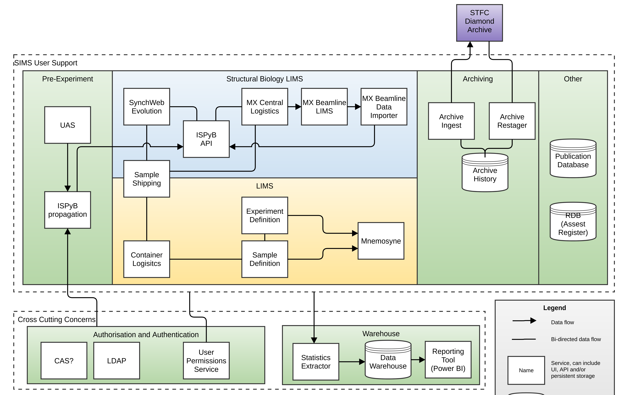
Structural Biology LIMS
ISPyB API – Better way of accessing information
Evolution of SynchWeb – Upgrade the legacy codebase
MX Central Logistics – Logistics of MX samples and containers
MX vision is beamlines run independently of core Diamond services
MX Beamline LIMS – independent data capture at a beamline
MX Beamline Data Importer – Imports the data back
Notes:
If this is to people interested in Structural Biology:
The next section looks at the Structural Biology Architecture. This includes these 4 areas
If NOT:
Structural Biology:
ISPyB API – Better way to access data stored in the ISPyB database because it allows for better separation and consistent rules
SynchWeb remains for but will be evolved to upgrade the code base. Making the tech stack more modern
The MX-Dewar MX-Logistics apps will be bought in to SIMS group .
MX want to split off the data collection from a central service so they are introducing MX Beamline LIMS system with an Importer/Exporter to the central system
Now skip to the next section

Slide 9
ISPyB API Migration Project
We have identified the users and usages:
~20 different "APIs" in use
~30 different, active database users
190 stored procedures of which only ~85 have been called in the previous run
The API will be:
Developed over the next 2 years
Built in collaboration with users of old "APIs" to create a common API for their use cases
Incrementally built and as functionality is migrated, other database access methods will be disabled
Owned and controlled by the LIMS team
Open to code contributions and feature requests from other groups at Diamond
A project proposal is being drawn up to ensure that all stakeholders have visibility of the migration process and understand their part in it.
Some functional areas with existing APIs will be easier to migrate, unused parts will be removed
We will migrate everything including legacy Diamond applications (e.g. "DB Server")

Slide 10
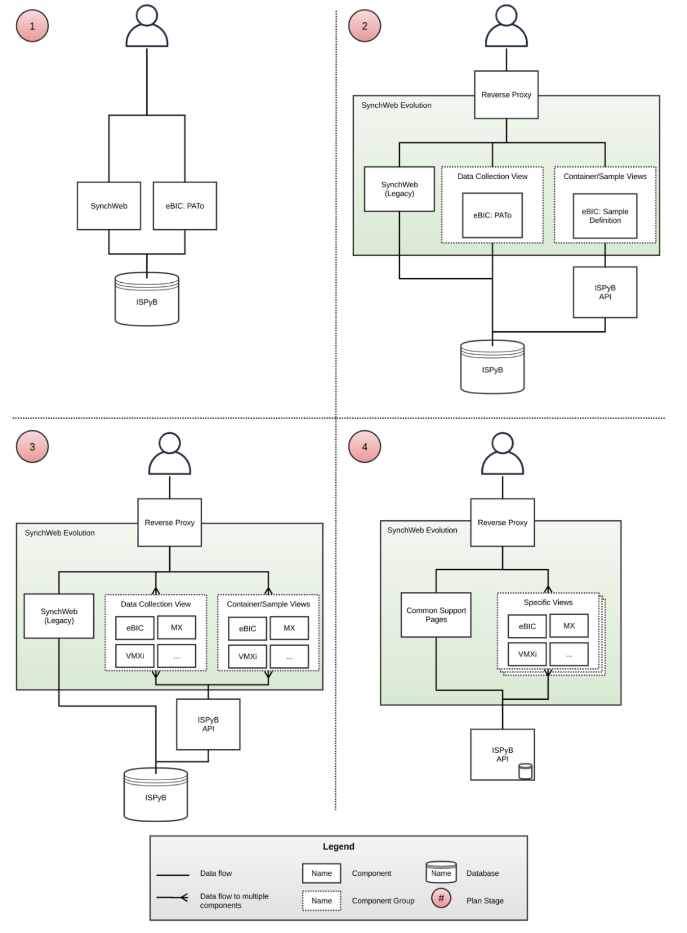
Evolution of SynchWeb
4 Planned Steps

Slide 11
SynchWeb Evolution Now and Illustrative future point
Steps 1-3: Current to Illustrative
Step 1: Now
Separate Applications
SynchWeb
PATo
Step 3: Indicative Migration
Appears as Single Application but made up of independently deployable applications
Data Collection view
1 for each area, e.g. eBIC - PATo
Container/Sample View
1 for each area, e.g. eBIC – eBIC Sample Handling
Use ISPyB API for new apps
Share code using a common library
Enables independent development and operation
Notes:
Most interesting steps 1 -> 3
1 is what we have now, SynchWeb and PATo (which shows data collection for eBIC) as two separate application. Different URLS no connection between them
3 is an illustration of a future step. Where some of the templated pages, data collection and shipping views, have all been moved to separate applications but implemented into a single framework.
Step 2 is creating the framework for this
Step 4 is removing all generic pages and removing any legacy code and replacing them with support pages

Slide 12
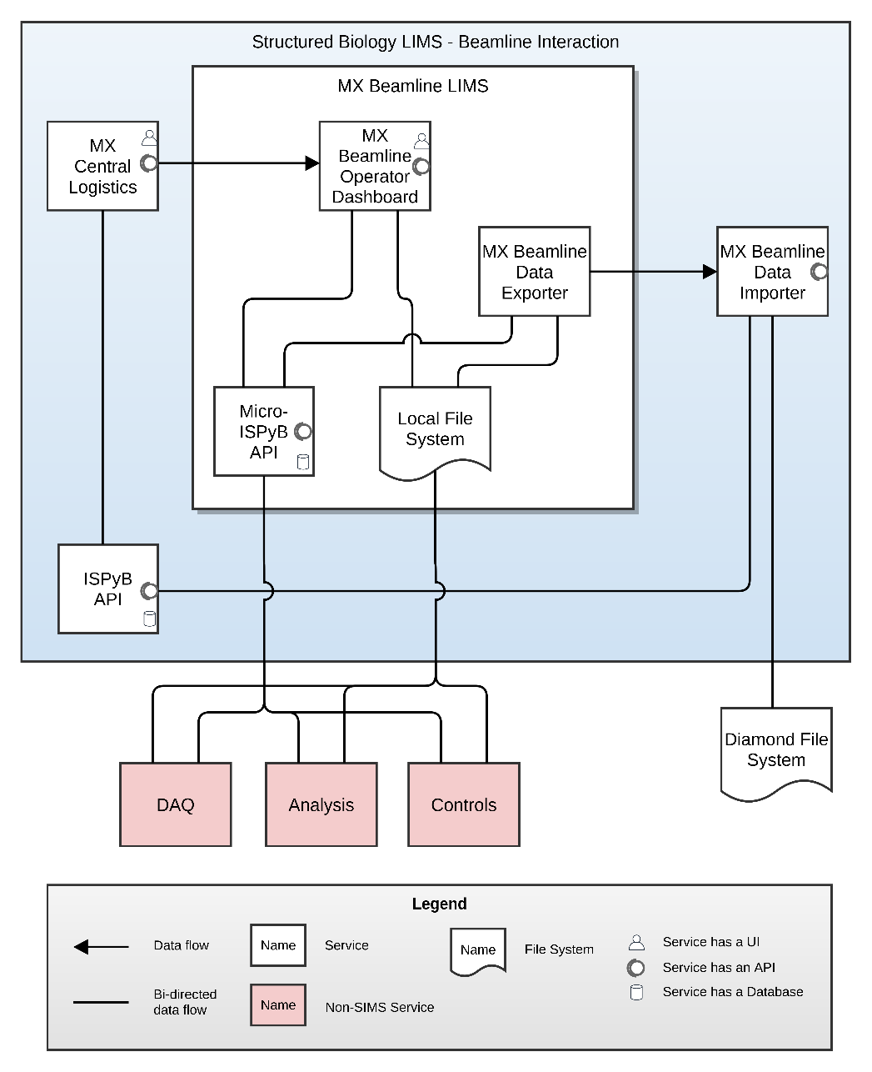
MX Beamline Isolation
Two parts one at the beamline one central to Diamond
Also supports MX Bridge
Future post Diamond-II
Micro ISPyB
Small ISPyB running at the beamline
DAQ capture experiment in micro-ISPyB API and local file system
MX Central Logistics
Dewars and pucks within Structured Biology
Connection to beamline
MX Beamline Operator Dashboard​
Monitoring on the beamline​
MX Beamline Data Exporter/Importer​
To get data from the beamline into central Diamond systems​

Slide 13
Questions

